Slide 1

Department of Computer Engineering
Code converters -
BCD, Excess-3, Gray code, Binary Code
1

Slide 2
Points covered
Department of Computer Engineering
Types of codes
BCD to Excess 3 code
Excess 3 to BCD code
Binary to Gray code
Gray code to Binary code
Quiz
2

Slide 3
Department Vision & Mission
Department of Computer Engineering
Vision
Achieve academic excellence through education in computing, to create intellectual manpower to explore professional, higher educational and social opportunities.
Mission
To impart learning by educating students with conceptual knowledge and hands on practices using modern tools, FOSS technologies and competency skills there by igniting the young minds for innovative thinking, professional expertise and research.
3

Slide 4
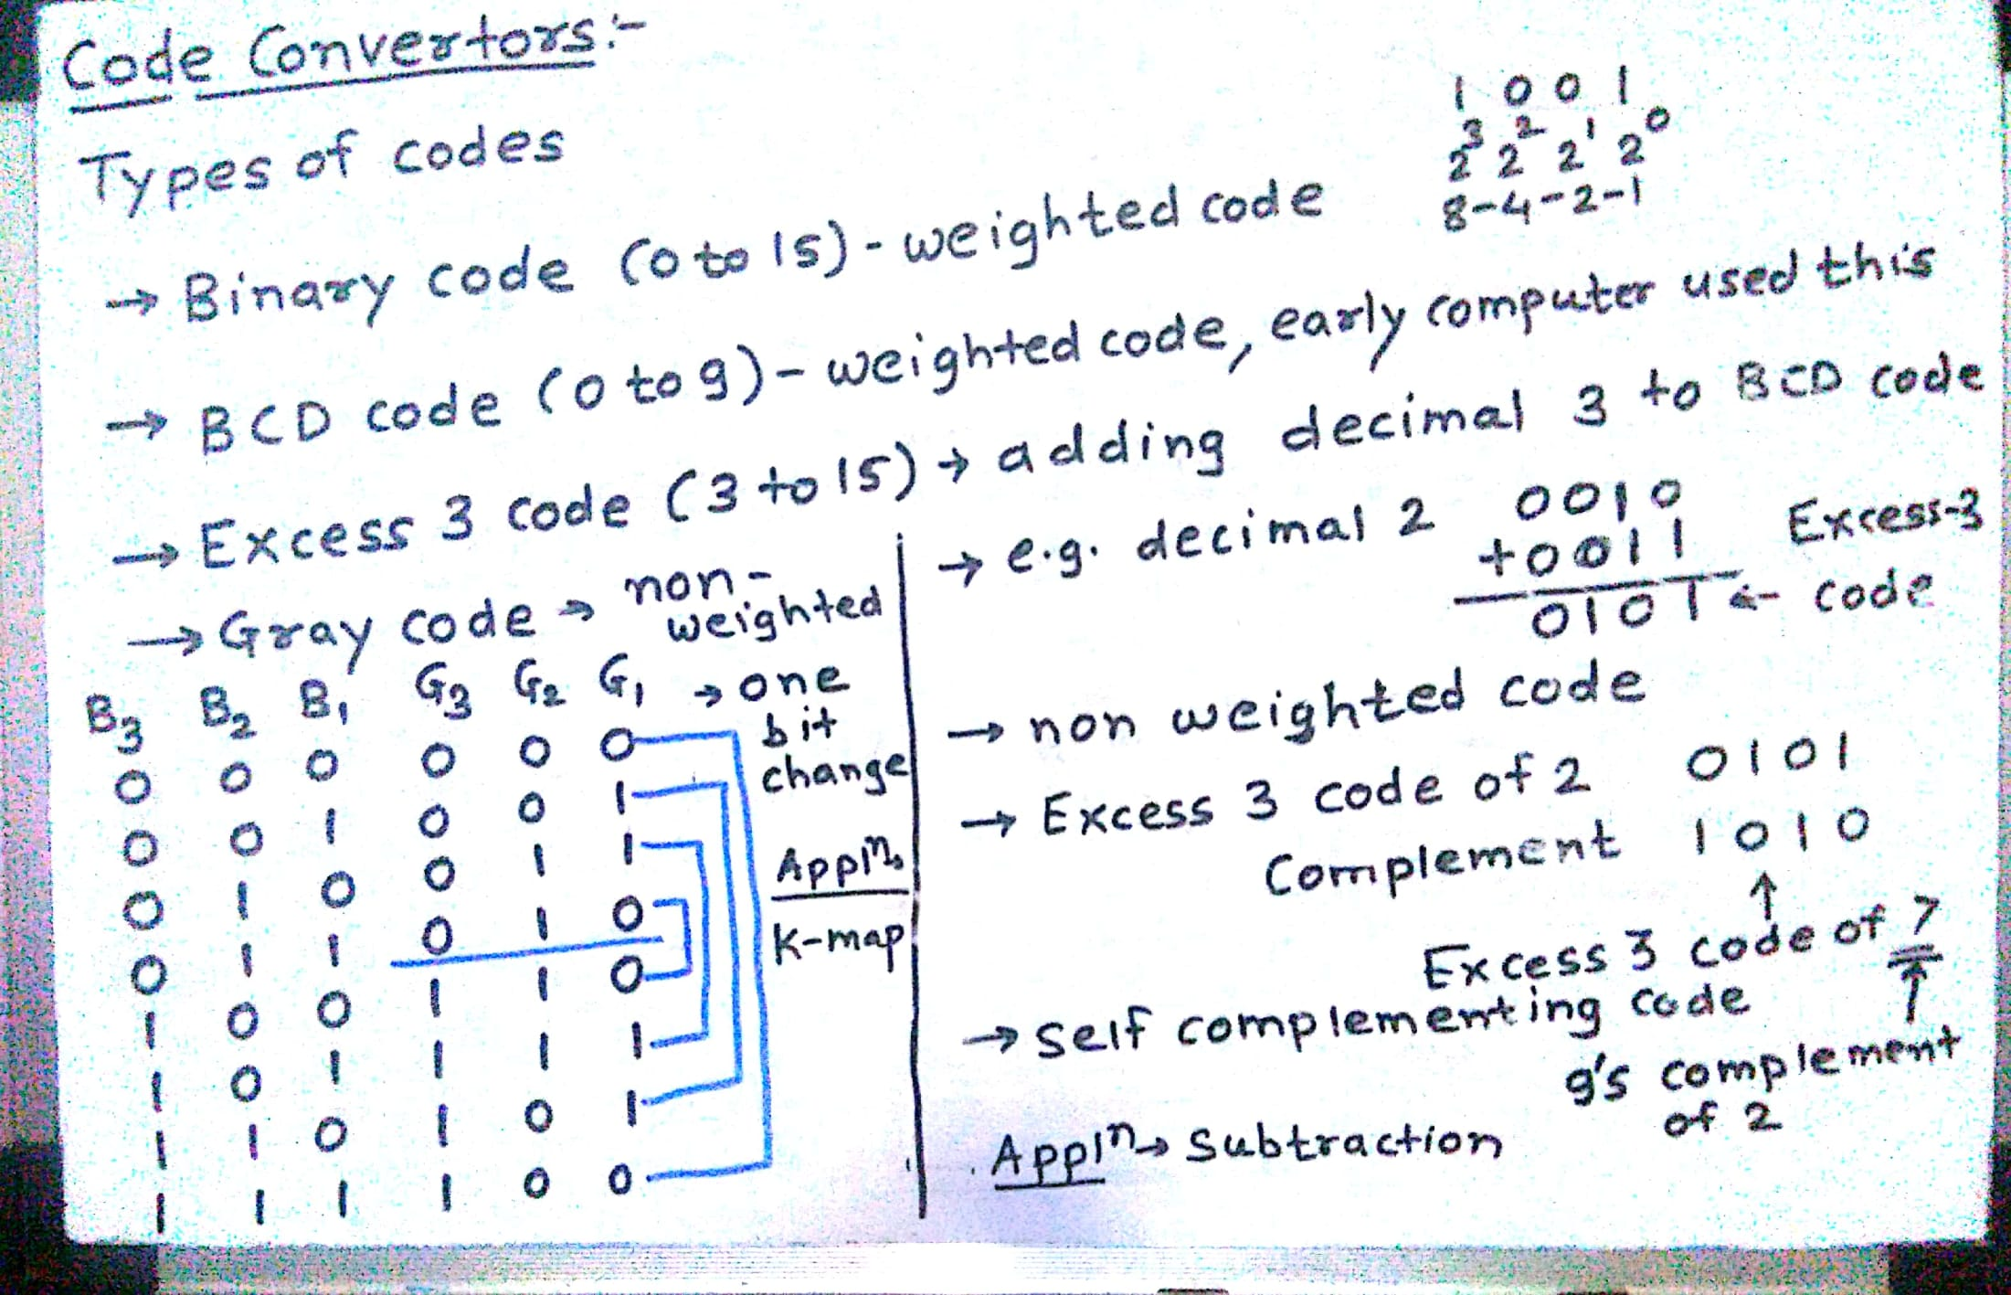



Types of codes
Department of Computer Engineering

Slide 5
Types of codes
Decimal symbol | BCD digit
0 | 0000=0011
1 | 0001=0100
2 | 0010=0101
3 | 0011=0110
4 | 0100=0111
5 | 0101=
6 | 0110
7
8
9 | 1001

Slide 6
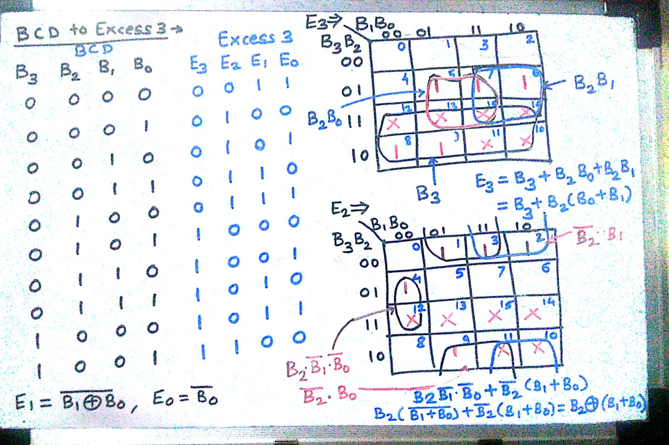





BCD to Excess 3
Department of Computer Engineering

Slide 7
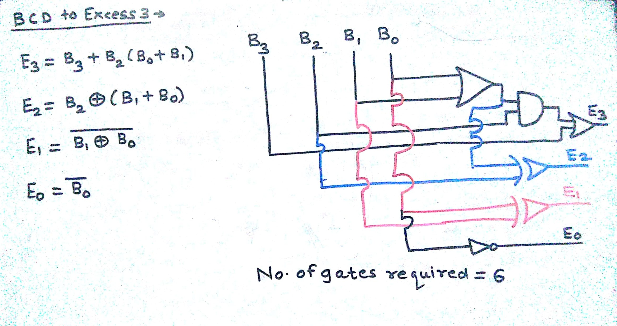
BCD to Excess 3
Department of Computer Engineering

Slide 8
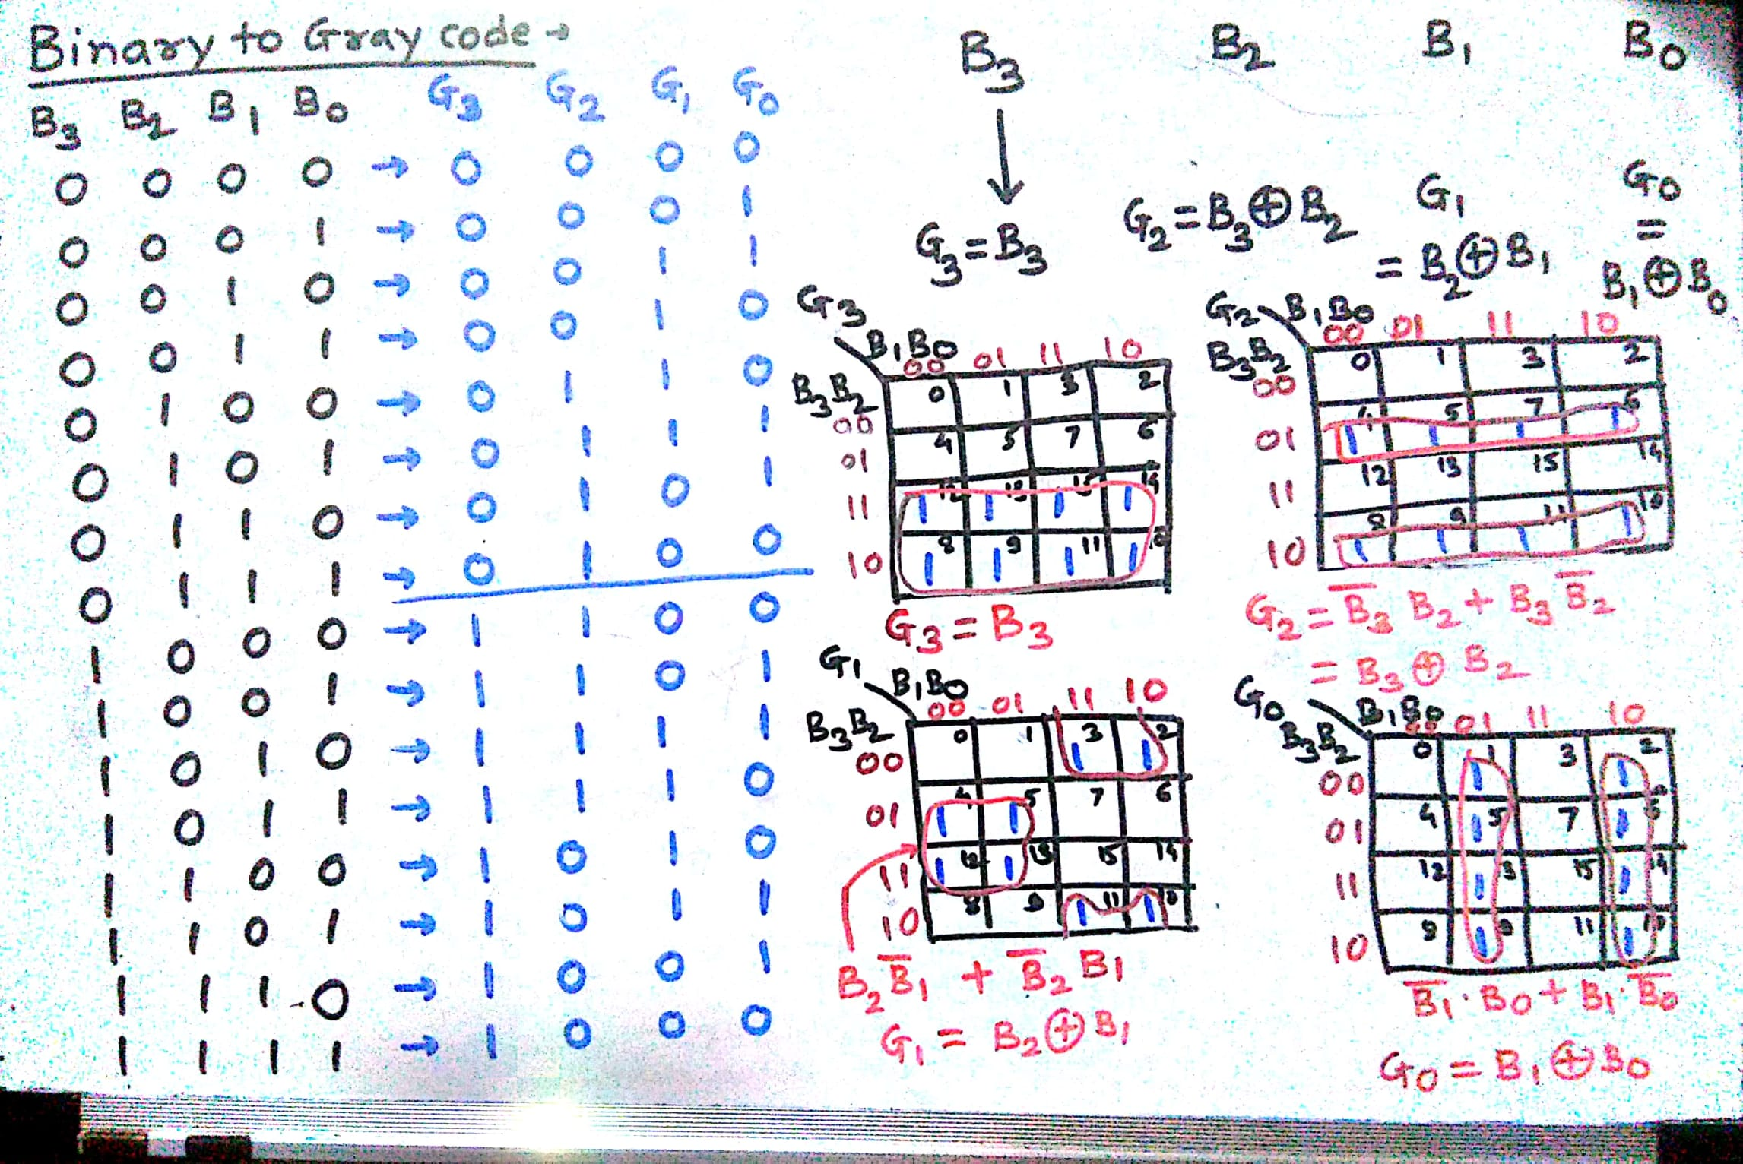




Binary to Gray code
Department of Computer Engineering

Slide 9
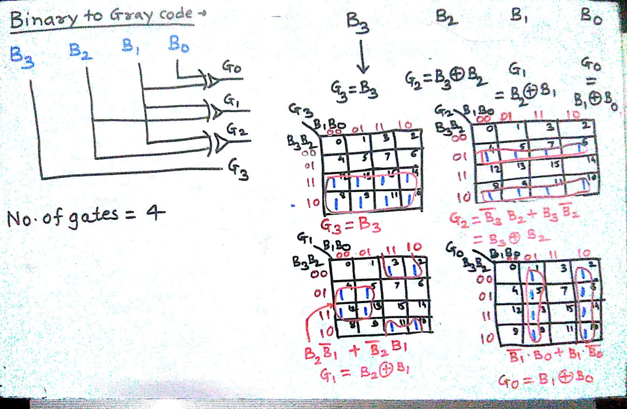


Binary to Gray Code
Department of Computer Engineering

Slide 10
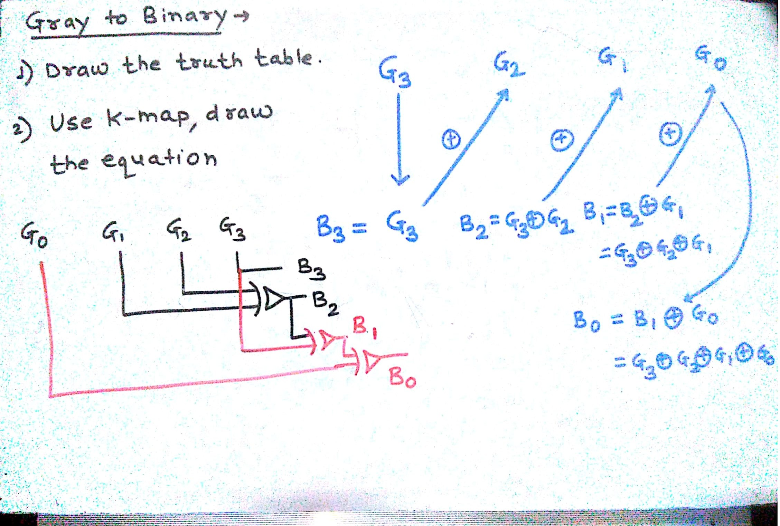
Gray to Binary Code
Department of Computer Engineering

Slide 11
Quiz
Please click the following link to open the quiz
testmoz.com/4312174

Slide 12
Summary
Department of Computer Engineering
Types of codes
BCD to Excess 3 code
Excess 3 to BCD code
Binary to Gray code
Gray code to Binary code
Quiz
12

Slide 13
Department of Computer Engineering
Thank you

